Slide 1


Springboard 5.0
Internship
Presented to: INFOSYS TEAM
Project Name:
Regulatory Compliance Checker for Legal Contracts with leveraging Al
Date:
Feb 2025

Slide 2
Introduction
Regulatory Compliance Checker for Legal Contracts with leveraging Al
Overview of the project goal is The Regulatory Compliance Checker for Legal Contracts leverages AI to automatically review and ensure that contracts adhere to relevant laws, regulations, and industry standards, reducing risk and saving time.
Infosys.com
2025

Slide 3
Project Objectives
01
Automated Compliance Analysis:
02
Natural Language Processing (NLP) Capabilities:
Implement advanced NLP techniques to accurately interpret and extract relevant information from legal texts. This will enhance the tool's ability to understand context and nuances in legal language.
04
Reporting and Documentation:
Generate comprehensive reports that detail compliance findings, potential risks, and suggested actions. These reports should be easily exportable and provide valuable insights for legal teams and stakeholders.
Develop an AI-driven tool that automatically analyzes legal contracts to ensure compliance with relevant regulations and standards. This includes identifying clauses that may violate regulatory requirements.
03
User-Friendly Interface:
Create an intuitive user interface that allows users to easily upload contracts, view compliance reports, and access recommendations for improvements. The UI should be designed with best UX practices to ensure a seamless experience.

Slide 4
Core Modules of Regulatory Compliance Checker for Legal Contracts with leveraging Al
01
Contract Upload and Storage Module: This module will handle the uploading and secure storage of legal contracts. It should support various file formats and ensure that sensitive information is protected.
03
User Interface Module: A user-friendly interfa. ce that allows users to interact with the tool. This module should facilitate contract uploads, display analysis results, and generate reports. It should be designed for ease of use, ensuring that users can navigate the tool effortlessly.
02
Compliance Analysis Engine: The heart of the tool, this module will utilize AI and NLP techniques to analyze contracts for compliance with relevant regulations. It will identify key clauses, flag potential violations, and provide insights based on the analysis..
04
Reporting and Documentation Module: This module will generate detailed compliance reports based on the analysis conducted by the engine. It should provide
clear insights, recommendations
for compliance export reports in
improvements, and the ability to various formats.

Slide 5
How Does it Work?
Step 1
Step 2
File Upload and Parsing:
Users upload legal contracts through a web interface, where the application securely stores and parses the document to extract text and relevant clauses.
Compliance Analysis:
The extracted text is analyzed using AI and Natural Language Processing (NLP) techniques to evaluate compliance with predefined regulatory requirements, identifying key clauses and potential violations.
Step 4
Reporting and Integration
Users can generate detailed compliance reports summarizing the findings, and the system can integrate with external databases to stay updated on regulatory changes.
Step 3
Results Presentation:
The analysis results are presented to the user, highlighting compliant and non-compliant clauses along with actionable recommendations for improvements.

Slide 6
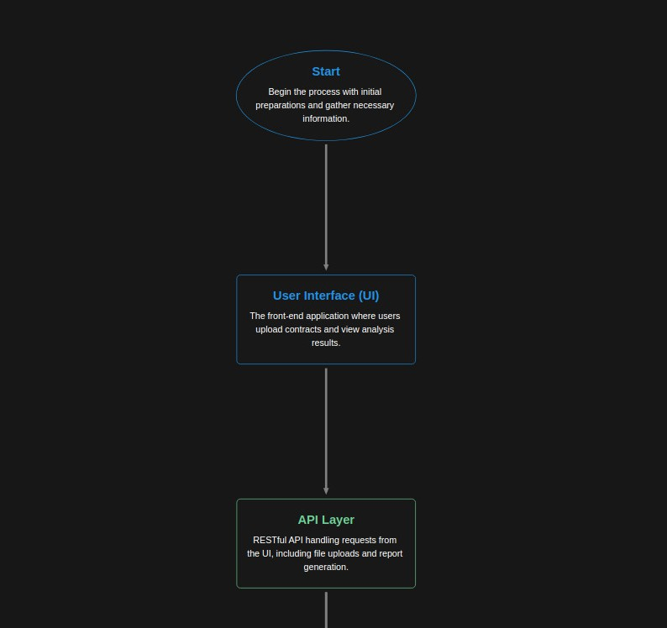
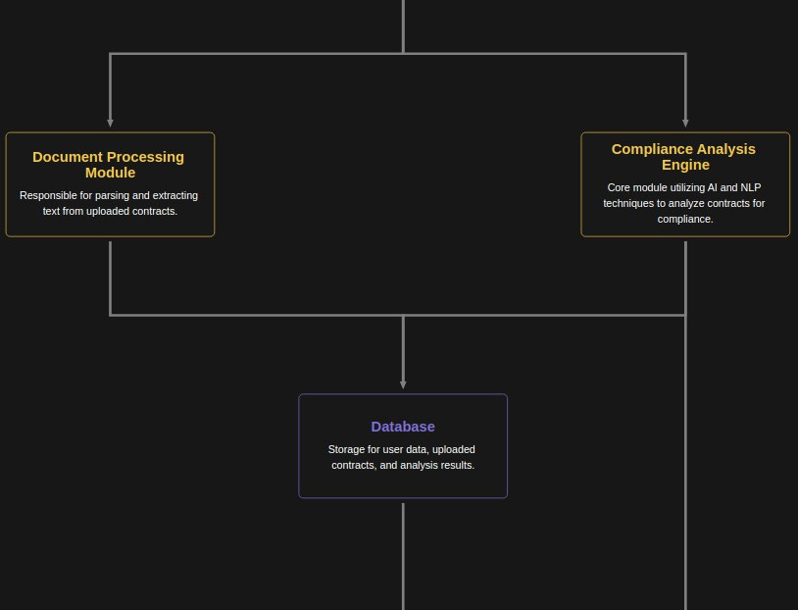
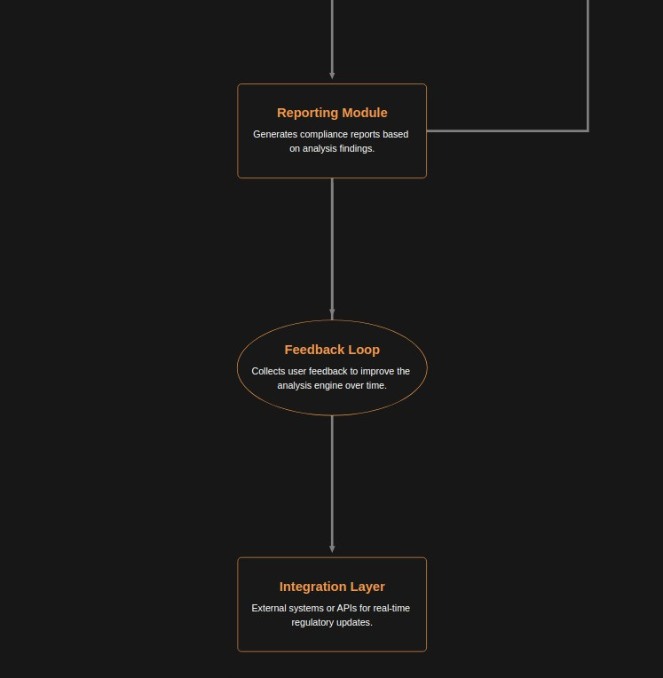
Architecture

Slide 7
Technology Stack
01
Frontend
HTML/CSS:For
02
Frameworks:
Streamlit: For building a responsive and modern user interface.
03
Backend
structuring and styling
the web interface.
Python: As the primary programming
JavaScript: For interactivity and
language for server-side logic.
dynamic content on the client side
FastAPI: To enable communication
between the frontend and backend.
06
API Key:
Groq API Key: As the primary api key we used Groq Cloud API key.
04
Document Processing:
PyPDF2 & python-docx: For parsing PDF and Word documents to extract text content. SpaCy: Natural Language Processing libraries for analyzing and processing the text.
05
Machine Learning Libraries:
scikit-learn: For implementing machine learning algorithms.

Slide 8
Features
Automated Compliance Analysis: Automatically evaluates legal contracts against regulatory requirements, identifying compliant and non-compliant clauses.
Natural Language Processing: Utilizes advanced NLP techniques to accurately interpret and extract relevant information from contracts, enhancing understanding of legal language.
User-Friendly Interface: Provides an intuitive web interface for easy contract uploads, analysis result viewing, and report generation.
Detailed Reporting: Generates comprehensive compliance reports that summarize findings, highlight risks, and provide actionable recommendations.
Real-Time Compliance Updates: Integrates with external regulatory databases to ensure the tool is up-to-date with the latest compliance requirements.
Feedback Mechanism: Allows users to provide feedback on analysis results, enabling continuous improvement of the compliance engine.
Secure Document Handling: Ensures that uploaded contracts are stored securely, with appropriate measures in place to protect sensitive information.

Slide 9
Future Expansion
Enhanced AI Capabilities: Implement machine learning algorithms to improve the accuracy of compliance analysis and adapt to evolving regulatory landscapes.
Multi-Language Support: Expand the tool to support multiple languages, allowing users from different regions to utilize the compliance checker.
Integration with Legal Management Systems: Develop integrations with popular legal management software for seamless workflow and data sharing.
User Role Management: Introduce advanced user management features, allowing for different access levels and roles within the application.
Custom Compliance Criteria: Allow users to define and customize compliance criteria based on specific regulations or organizational needs.
Audit Trail and Logging: Implement detailed logging of user actions and changes to documents for compliance auditing purposes.
Interactive Dashboards: Develop interactive dashboards that provide visual insights into compliance trends and analysis results over time.

Slide 10
Conclusion
The Regulatory Compliance Checker for Legal Contracts successfully streamlines the process of ensuring adherence to laws and regulations using AI. It minimizes manual effort, reduces compliance risks, and enhances accuracy in contract reviews.
This tool empowers businesses to maintain legal integrity while improving efficiency and cost-effectiveness.

Slide 11

Thank You!

